Slide 1
ChainShot Project
Block-chain for Insurance Data Management

Slide 2
Problem:
Data sourcing and management in large insurance companies, operating in multiple regions, and interacting with third-party systems, is a significant industry challenge resulting in inaccurate and inconsistent management reporting and financial analysis. To combat this risk, insurance companies undertake expensive data warehousing projects, often spending millions of dollars on implementation, maintenance, and support, to solve intra company data management issues. The end-state, however, becomes more complex when systems are in different regions espousing differing data policies and privacy restrictions, particularly when required to interact with third party systems outside of the company’s network.

Slide 3
Proposed Solution:
Use of a digital ledger, which can be accessed by authorized node owners and updated real time in a block chain network, and act as a substitute to data file exchange.

Slide 4
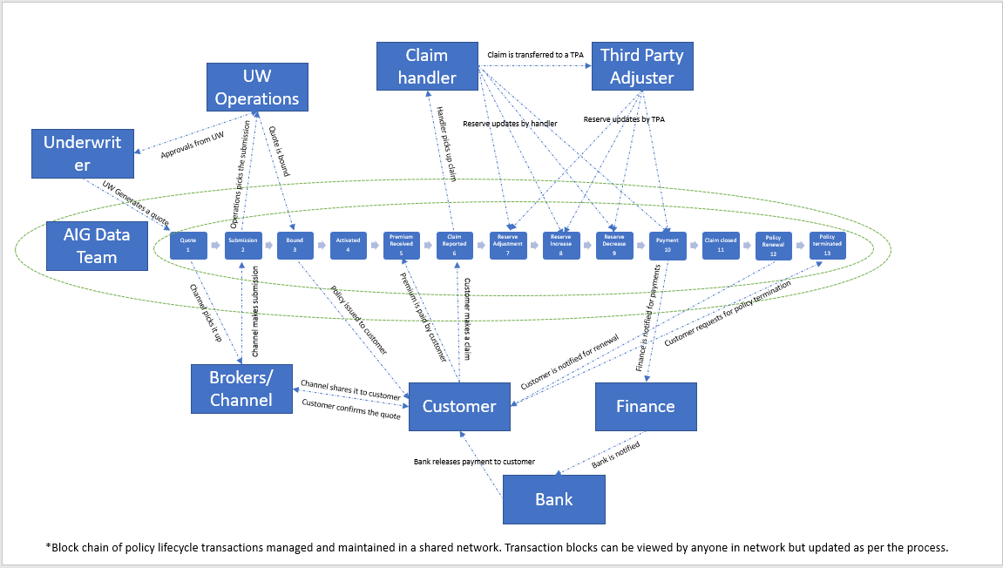
Activity Mapping:

Slide 5
Idea in Theory:
Insurance policy lifecycle can be represented in a series of reinforcing steps, from inception to termination, which can be defined as transactions
Each transaction type can be represented as a block, which will contain the data in an encrypted format using cryptography
Each block with encrypted data will reinforce on the previous one to build and complete the lifecycle of the respective policy. These transactions can be a shared with a network of nodes or stake holders who can view and update the relevant blocks as per the process using the encryption key assigned by insurer.
Since the lifecycle of a policy is transparent within a network, data about the policy and transactions can be viewed real time with all the parties involved.

Slide 6
Codifying Transactions Using SHA-256 cryptography
Policy sample data in a block-
Data Structure- Transaction Indicator-Policy Number-Transaction type (original premium)-Premium Amount- Payment Mode- Timestamp
Actual Data- P-12345-1-200- bank transfer- 15/12/2021 00:23
Public Key- bde508d8050d435b9adca4a28656f3582190ed48a1bdb81408f35d52c7cd612a

Slide 7
Rainbow table for policy data-
Key | Definition | Possible combinations
Transaction Indicator | P for policy or C for claims | 2
Policy number | Number of policies in blockchain | 1-n depending on the issuance
Transaction type | Transaction type codes | 98
Amount | Premium Amount | As per the policy agreement
Payment mode | Mode of payments | 3-4
Time stamp | Date and time of transaction | DD-MM-YYYY HH: SS combinations

Slide 8
Claim level data
Claim sample data in a block-
Data Structure- Claim Number-Policy Number- transaction type code (new advice)-Claim Amount- Claimant name (ADAM SMITH)- Timestamp
Actual Data- C-12345A-12345-11-2000-ADAM SMITH-15/12/2021 00:23
Public Key- 55ab01084489e28f8d41d72f612fdafb14187552ce47421fc347b344eabb96dc

Slide 9
Rainbow table for claims data-
Key | Definition | Possible combinations
Transaction indicator | P for policy or C for claims | 2
Claim number | Claim + Feature reference | Specific claim numbers will correspond against policy number as per the policy document (1-n). Feature reference will be as per the product type (A-Z).
Policy number | Number of policies in blockchain | 1-n depending on the issuance
Transaction type | Transaction type codes | 98
Amount | Claim Amount | As per the policy limit
Claimant name | Name of the claimant | As per the policy agreement
Time stamp | Date and time of transaction | DD-MM-YYYY HH: SS combinations

Slide 10
Thanks!

